Slide 1
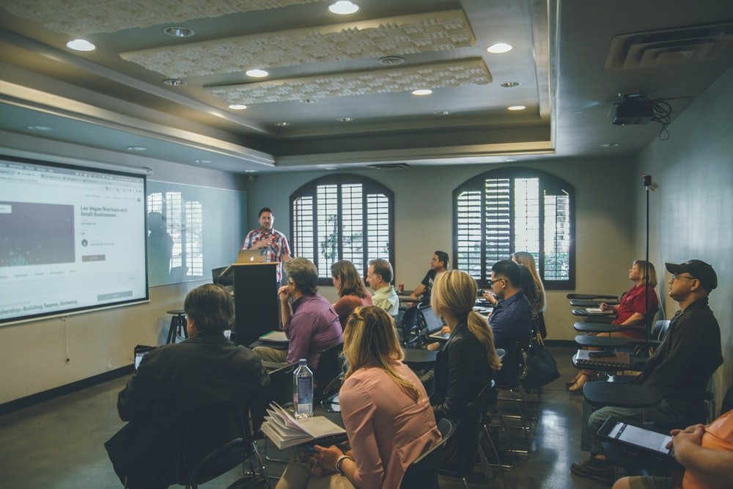
Foundations of Entrepreneurship
Lecture Note # 21
Pitching
04.03.2021

Slide 2
Elevator Pitch
Ideal size of the slide deck
Guidance for a right pitch

Slide 3

The Art of the Start: The Time-Tested, Battle-Hardened Guide for Anyone Starting Anything
“It begins with a dream that just won’t quit, the once-in-a-lifetime thunderbolt of pure inspiration, the obsession, the world-beater, the killer app, the next big thing. Everyone who wants to make the world a better place becomes possessed by a grand idea.”

Slide 4
Elevator Pitch or speech
Also known as an Elevator Speech or Elevator Statement
It is a precise description of your company to convey the desired information in the least of words so that one can get a holistic view about your strengths.
You want to convey your unique expertise and credentials quickly and effectively with people who matter but don't know you.
It is a short well-prepared speech.

Slide 5
Elevator Pitch or Speech
No longer than 60 seconds, ideally 20 to 30 seconds
Objective is to help your audience with relevant and enough information for them to decide if your proposition is of interest to them.
Ideally, it should convey what makes your offering unique.
Try explaining why should one think that you will succeed?

Slide 6
Elevator Pitch or speech in a nutshell
Who you are. What is your vision?
What you do.
Why you have a winning proposition. What is your USP.
Deliver something for future reference.
You may seek an appointment for further clarification.
Practice, practice and practice.

Slide 7
An Example
We support the consumer durable companies to manage customer experience. Post sales by our clients, our company remains engaged with their buyers and service engineers to answer all queries and troubleshoot every complaint so that customers get exciting experience and the sellers get a five star rating. We charge 2% of sales value and our cost so far is about 50% of that. We are present in parts of Mumbai serving two multinationals who have recorded visible improvement in review and sales. It is still a niche market and we would like to spread in larger geographies before competition sets in. India’s consumer durable market is $50 billion, thus the serviceable available market size is $5 billion and we target to obtain 10% of this market in the next two years giving us annual profit of $5 million. A million dollar of funding should take us there. The investment can potentially return 10X in five years.

Slide 8
Dos and don'ts While Pitching
Do not be verbose.
Keep something that you can give at the end both for reference and for refreshing memory later: say a brief but catchy flyer and a visiting card. [a calendar, something to place on the table, be innovative]
Practice and practice. Refine as much as you can based on experience.
Do not speak too fast. Mindfully, change the pitch of your voice.
Don’t do rambling.
Remain open to interjection by your audience at any time.
Notes:
jargons

Slide 9
Guy Kawasaki
Guy Kawasaki is the chief evangelist of Canva, an online graphic design tool. Formerly, he was an advisor to the Motorola business unit of Google and chief evangelist of Apple.
The 10 – 20 – 30 rule recommended by Guy Kawasaki
“I am evangelizing the 10/20/30 Rule of PowerPoint. It’s quite simple: a pitch should have ten slides, last no more than twenty minutes, and contain no font smaller than thirty points.” - Guy Kawasaki

Slide 10
1. Title
2. Problem/ Opportunity
3. Value Proposition
4. Underlying magic
5. Business Model
Company name, your name & title, address, email, and cell number
The pain that you are alleviating or the pleasure you are providing
What reasons the customers will find to buy your’s than competitors
Technology, secret sauce, or magic behind your product
Especially the revenue model and how you are going to earn it.

Slide 11
6. Go-to-market plan
7. Competitive analysis
8. Management team
9. Financial Projection
10. Traction, timeline, use of fund
How you plan to reach customers at minimum cost?
What are your strengths vis-à-vis competitors
Complement-ary key skills of the management team
Three year forecast of revenue, profit, number of customers
Current status, immediate future, how you plan to use the money

Slide 12
Additional Information
Product demo – if you are ready with it. Present it after slide No. 4
The reward to the investors
The desired fundraising
All templates, more or less, contain the same information.
It is not the format or the template that matters but the contents that you provide.
Satisfy yourself of a winning proposition. Do not settle with ENOUGH REASONS for winning, but have compelling reason for anybody to ask you to take their money.

Slide 13
Guy Kawasaky says
The less text and the more diagrams, schematics, and flowcharts the better.
If you have a prototype or demo, transition to it after slide No. 4.
As Glen Sires of Google said “If a picture is worth 1,000 words, a prototype is worth 10,000 slides”.

Slide 14
Example
AirBed&Breakfast – AirBnB – winning pitch deck

Slide 15
The Airbnb Pitch Deck Slide Layout
Cover
Problem
Solution
Market Validation
Market Size
Product
Business Model (revenue)
Market Adoption
Competition
Competitive Advantages
Team
Press
Users Testimonials
Financial
https://slidebean.com/templates/airbnb-pitch-deck

Slide 16
The Problem
Price is an important concern for customer booking travel online.
Hotels leave you disconnected from the city and its culture.
No easy way exists to book a room with a local
or become a host.
https://slidebean.com/templates/airbnb-pitch-deck

Slide 17
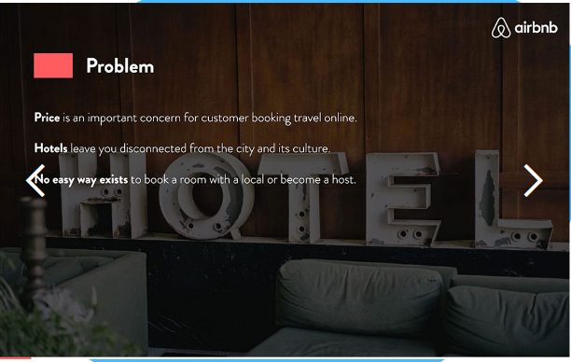

Slide 18
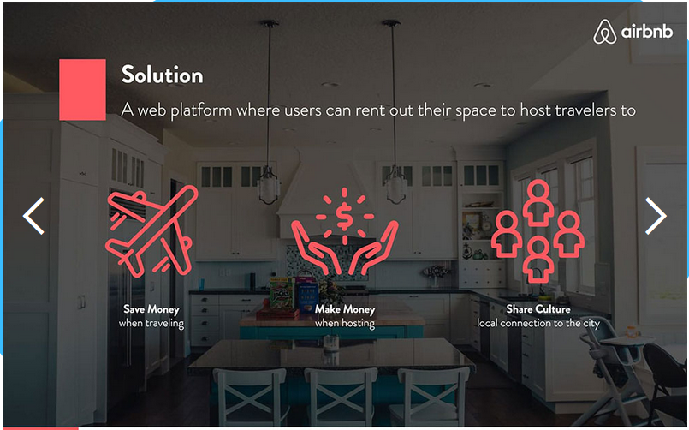

Slide 19
Market Validation
Total users in craigslist.com at 670,000
Temporary housing listing at Couchsurfing.com at 17,000
Market Size
Total users in craigslist.com at 670,000
Temporary housing listing at Couchsurfing.com at 17,000
2+ Billion | 560+ Million | 84 Million
Trips Booked (WorldWide) Total Available Market | Budget&Online Serviceable Available Market | Trips w/AirBnB 15% Obtainable Market

Slide 20
Product – 4 slides
Product showing interior of a room & a laptop
Search by city with images from different countries
Review listings – images of properties with map
“Book it!” – with an image of beautiful interior of a room with the sea visible through the window.
https://slidebean.com/templates/airbnb-pitch-deck

Slide 21

Business Model we take a 10% commission on each transaction
$84 $25 $200
MILLION DOLLARS AVERAGE FEE MILLION DOLLARS
Trips with AirBnB $80/night Revenue
15% of Available Market for 3 night Projected by 2011

Slide 22

AFORDABLE
Competitor
OFFLINE TRANSACTION
ONLINE TRANSACTION
Competitor
Competitor
EXPENSIVE

Slide 23
Competitive Advantage
First to Market Ease of Use Profiles
For transaction-based search by price, location & browse host profiles,
Temporary housing site check-in/check-out dates and book in 3 clicks
List Once Design and Brand Host Incentive
Hosts post one time vs. Memorable name will launch at they can make money
Daily on craigslist historic DNC to gain share of mind over couchsurfin.com

Slide 24
User testimonial
Press reports

Slide 25
Financial
We are looking for 12 months financing to reach 80,000 transactions on AirBed&Breakfast
$500K 80K guests $2 M
Angel Round Trips w/AirB&B Revenue
Initial investment opportunity avg $25 fee over 12 months

Slide 26
A good start can be a very short story explaining where you come from provided it captivate them in it.
You may use your 20 – 60 seconds pitch as the introduction.

Slide 27
You must plan, rehearse and perform in front of a live audience.

Slide 28
Some Dos and Don’ts
Present yourself in good attire. We all judge a book by its cover. Dress is almost half of your presentation.
Remain relaxed.
Do not stick to the ground.
Do not engage in self-praising or battering the competitors.
Avoid the podium.
“PowerPoint is not the message nor the messenger.” - David Fernandez. “You are the messenger, and what comes out of your mouth is the message. PowerPoint is simply there to help.”

Slide 29
Words are tools for conveying ideas.
Investors are busy.
They want you to convey as much as possible in as less words.
No poetic phrases
Anybody loves to hear a good story with strong words.
Gather all possible information about pitfalls.
Notes:
Painting a mental picture of how a specific customer will benefit or has already benefited from the new product or service packs a wallop.

Slide 30
Let your movements mirror what you are saying
Hold your gaze for a few seconds with each of your audience
Listen as long as someone is talking. Let him/her complete.
Mirroring body language may create bond and comfort/likability
Mild smiling can make you seem approachable, pleasing, more sure of yourself.
Fidgeting is a clear indication that you lack confidence and rather nervous. Be mindful of your facial expression and your limbs. Be aware of your actions.

Slide 31
Pitching
Start with an infographics – if possible.
Bring something tangible to show (if possible)

Slide 32
Story Telling
Many potential employees will feel passionate to work with you just for the purpose your company works for. Your story may make them dedicated and give their best.
Potential investors buy into the narrative and try to gauge your conviction in the cause and your tenacity, and seriousness.
Customers are getting increasingly connected to your narrative. Data shows that about 70% of millennials prefer to buy brands that supports great social cause, particularly those that they care about.
Delivering a compelling story can be more persuasive than projecting growth. Do both.

Slide 33
Entrepreneurial story tells the core vision, where you come from, where you aim to be, and where you are now.
You can take all on board for a shared vision by your narrative. You can invigorate all the stakeholders into action that will further your story.

Slide 34

Example: Blake Mycoskie
Blake Mycoskie traveled the world
He discovered children walking without footwear.
He realized it as a devastating reality of children in a small village, and was looking for idea to help.
He hits upon an idea and executed. His idea not only provided children around the world with much needed footwear, but stakeholders rallied around the cause, and made ‘TOMS’ a household name.

Slide 35
The Elements of a Wining Entrepreneurial Story
Richard Maxwell and Robert Dickman recommended five building blocks of a compelling story:
Hero – the agent of change (Blake Mycoskie is the hero in his venture)
Antagonist – the force against which your story pushes
Awareness – the moment at which a solution is discovered or the narrative reaches a turning point.
Transformation – the moment at which you realize the results of the hero’s efforts. and
Passion – The driving force behind your entrepreneurial story
These are your fundamental building blocks -- you don’t have a compelling story if you don’t have a firm grasp of these.

Slide 36
You should remain prepared to pitch in one sentence, one minute, and ten minutes as the context demands.
“The success of your presentation will be judged not by the knowledge you send out but by what the listener receives.” - Lily Walters
“It takes one hour of preparation for each minute of presentation time.” - Wayne Burgraff

Slide 37
It is a good idea to keep a short video pitch of about two minutes ready. Post it on a privately sharable YouTube channel.
It would be handy in the context of a telephonic introduction.
Your message should make a mark, something memorable and your audience should easily recount to others.

Slide 38




30 seconds pitch
The pain point
The solution
The market and the reward?
Traction
And financials?
How compelling is the pain and are people crying for a solution?
Core functions of your product/ service. The core value proposition. The USP.
What is the total
market size, how
much is serviceable
and how much is obtainable?
You need to convey that you are moving quite fast. Idea to first prototype to market validation and go-to-market

Slide 39
Two Minutes Pitch
Four points
Unique insight – competitive advantages the aha moment.
How you make money – business model, how you monetize.
Team – credentials, how many engineers, MBAs, experience, how you met, accomplishment.
How much money ($$$) you ask – must do the homework. If questioned as to how do you propose to use it, must not blubber.

Slide 40
When to fundraise?
Ideally, try gaining as much traction before asking for money. At that point investors would be asking you to take their money.
Empirical evidence indicates that 90% of the startup can actually take their product to market with very little money.
Ask as much money that can take you to the next milestone even if that is small.
Do not show desperateness.

Slide 41
Design with colors Colors Trigger Different Emotions

Slide 42
Color Wheel
https://www.youtube.com/watch?v=L1CK9bE3H_s
Primary
Red
Blue
Yellow

Slide 43
Color Wheel
Secondary
Purple
Green
Orange

Slide 44
Color Wheel
Tertiary colors

Slide 45
Complementary Colors or Split Complementary: Colors sitting across in the color wheel Placing them side-by-side can create great contrast and visual interest

Slide 46
Triad & Tetradic Color Combination Triadic scheme: is evenly spaced three colors. Tetradic Color: four colors arranged with two sets of complementary colors

Slide 47
Analogous color scheme: 2 to 4 contiguous colors

Slide 48

http://getdrawings.com/free-powerpoint-vector-graphics

Slide 49
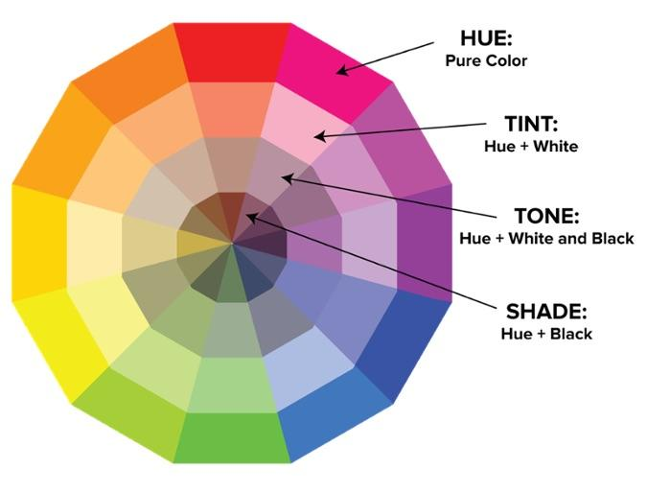
Color terminology
Hue: Pure color (different values)
Chroma: degree of vividness of a color
Saturation: the strength or weakness of a color
Value: how light or dark a color is
Tone: hue + white + black
Shade: hue + black
Tint: hue + white

Slide 50
Monochrome: Different Hues
Different hues of the blue

Slide 51
Monochrome
Different hues of the blue
Foundations of Entrepreneurship
Design with colors
Different hues of blue
Blue is the color theme here

Slide 52
Painters’ Color Mixing Terminology
White
Tint
Gray
Tone
Pure color
Shade
Black

Slide 53
Every Color is Associated to Some Emotion Bright colors are for fun or modern vibes
Red
energy, power, passion
Orange
joy, enthusiasm, creativity
Yellow
happiness, intellect, energy
Green
ambition, growth, freshness, safety
tranquillity, confidence, intelligence
Blue
luxury, ambition, creativity
Purple
power, elegance, mystery
Black
cleanliness, purity, perfection
White

Slide 54
Develop a Visual Theme
Use theme to create a cohesive narrative of the entire presentation

Slide 55
Yellow
Cheerful or warm
Most likely to strain eyes or cause eye fatigue
Makes babies cry – so avoid in places where babies are expected spend time.
The happiest color in the color spectrum also increases metabolism and gives the body a surge of energy.

Slide 56
Blue – the color of the sky and the sea
Most preferred by men
Represent calmness and serenity
Offices largely use this color
Water and peace are associated with this color
Induce the minds to think creatively or think out of the box and to be productive and improve performance
Color of corporate logos are sometimes blue in order to convey innovation-driven
Flip side: blue suppresses appetite

Slide 57
Green
Known to promote inner tranquility.
Helps mind to trust and facilitate good health.
Food items labeled in green evoked a sense of healthiness and usually sells more compared to those labeled in say, red.

Slide 58
Orange
Lively and it excites the brain.
Invigorates enthusiasm.
A deeper shade is associated with warmth, and brighter shed indicates caution and one should be vigilant.

Slide 59
Pink
Calmness and warming
Signifies love, womanhood and femininity.
Many prisons paint the walls pink to calm down some of the most aggressive prisoners. Pink color calms children down.

Slide 60
Purple
The royal, wealthy and successful dress in purple. It provokes elitist thoughts.
Lavender, the lighter purple, calms a person who is in an anxious or nervous state and helps them to relax.

Slide 61
Black
Usually, death and mourning.
In some contexts, represents sophistication.
People wearing black tend to be aggressive.

Slide 62
White
Purity and innocence, also emptiness.
It reflects the full force of the spectrum into our eyes.
White is purity and convey a sense of “touch me not”.
Represents cleanliness, hygiene, and sterile.

Slide 63
60-30-10 Rule
60% of your slide — primary color
30% — secondary color
10% — accent color
60% is your dominant hue, 30% is your secondary color, and 10% is for an accent color.

Slide 64


Slide 65


Slide 66
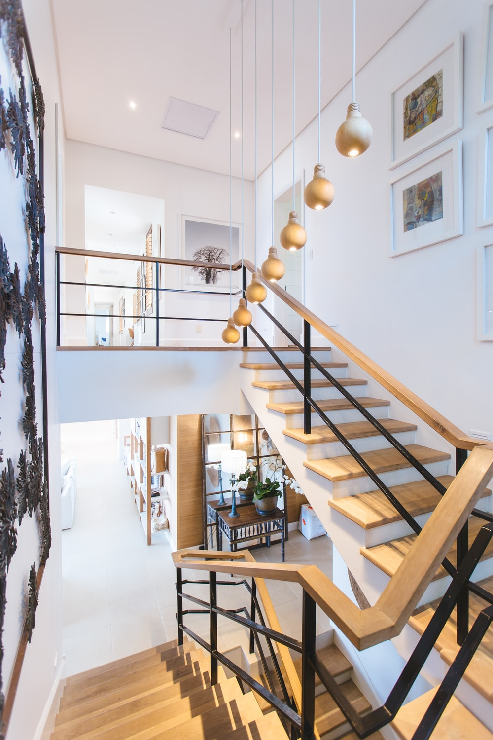


Slide 67




Contrast Adds a Lot of Visual Pleasure and Bring Sharper Focus

Slide 68

Simple is Beautiful

Slide 69
Desaturated colors often appear more business-like.
Baby food
Health food
Energy food
MARKET SEGMENTS
For the year 2019-20
Presented by
XYZ etc.

Slide 70
Desaturated colors often appear more business-like.
Baby food
Health food
Energy food
MARKET SEGMENTS
For the year 2019-20
Presented by
XYZ etc.

Slide 71
https://www.forbes.com/sites/robinbruce/2017/03/17/building-your-entrepreneurial-story/#1c9ce23511a9
http://www.color-wheel-pro.com/color-meaning.html
https://www.youtube.com/watch?v=L1CK9bE3H_s

Slide 72
https://encycolorpedia.com/
https://unsplash.com/s/photos/background for images
https://www.youtube.com/watch?time_continue=231&v=SB16xgtFmco&feature=emb_logo
https://slidebean.com/templates/investor-deck-template
https://guykawasaki.com/the-only-10-slides-you-need-in-your-pitch/
https://slidebean.com/templates/investor-deck-template
Various Wikipedia pages

Slide 73
Create empathy with the investors, understand their risks and aspirations.
Try eliminating questionable statements.

Slide 74
https://unsplash.com/s/photos/background for images
https://www.youtube.com/watch?time_continue=231&v=SB16xgtFmco&feature=emb_logo
https://slidebean.com/templates/investor-deck-template
https://guykawasaki.com/the-only-10-slides-you-need-in-your-pitch/
https://slidebean.com/templates/investor-deck-template
Various Wikipedia pages

Slide 75
Create empathy with the investors, understand their risks and aspirations.
Try eliminating questionable statements.

Slide 76
Thank You

